Slide 1



Ocean and Marine Life Analysis
View in Power BI
Last data refresh:
30/04/2025 19:17:53 UTC
Downloaded at:
30/04/2025 19:19:22 UTC

Slide 2
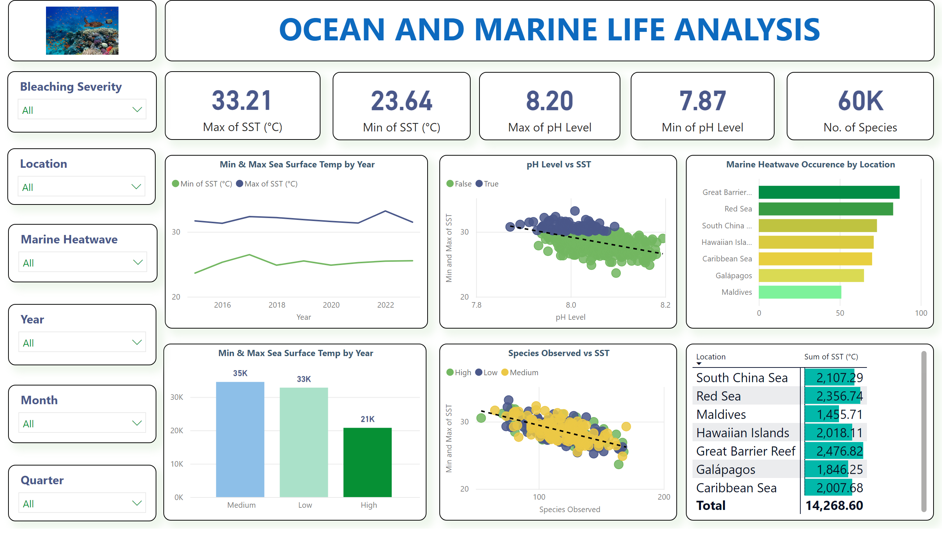
Page 1
Notes:
textbox
No alt text provided
image
No alt text provided
card
No alt text provided
card
No alt text provided
card
No alt text provided
card
No alt text provided
card
No alt text provided
slicer
No alt text provided
slicer
No alt text provided
slicer
No alt text provided
slicer
No alt text provided
slicer
No alt text provided
Min & Max Sea Surface Temp by Year
No alt text provided
pH Level vs SST
No alt text provided
Marine Heatwave Occurence by Location
No alt text provided
Min & Max Sea Surface Temp by Year
No alt text provided
Species Observed vs SST
No alt text provided
pivotTable
No alt text provided
slicer
No alt text provided

